Slide 1
Machine Learning in STEM 2023 Transmission Electron Microscopy
Gerd Duscher
gduscher@utk.edu
Professor: Materials Science
Director: Microscopy Facility

Slide 2
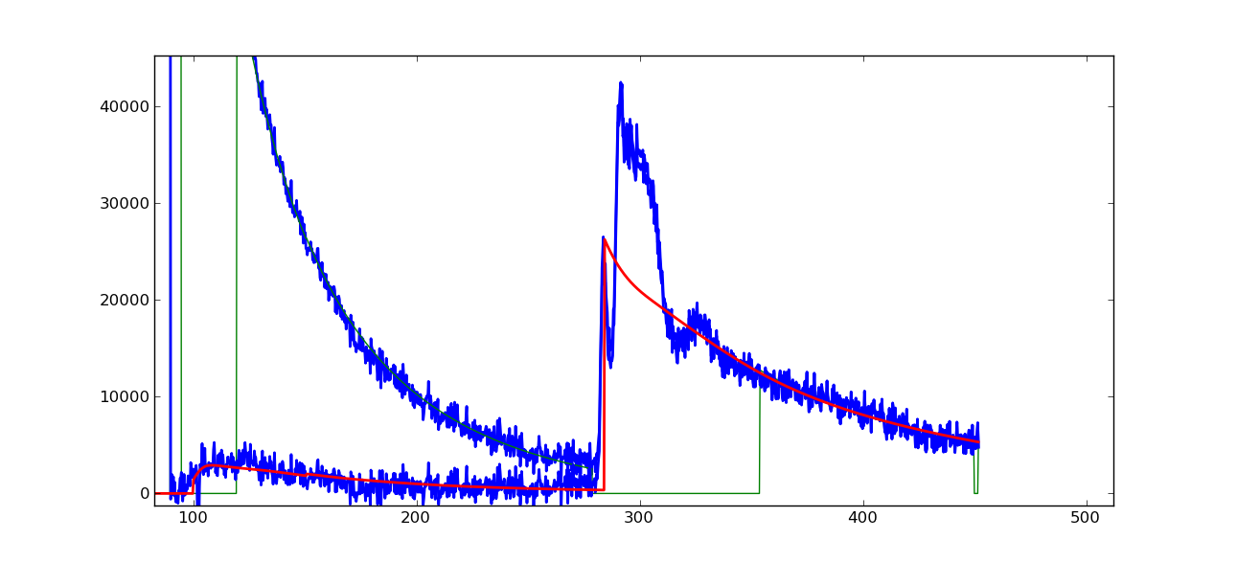
What is that bright atom in the carbon nannohorn?
15º tilt
C-K
Si-L₃
Si/C ratio = 0.7 with 144 atoms in analyzed area that gives 1 Si atom

Slide 3
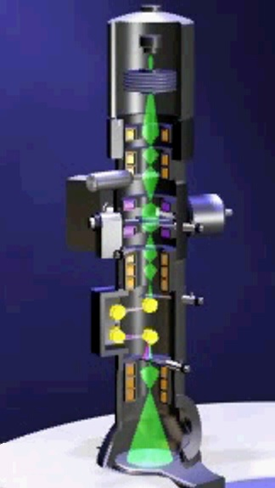
Instrument
A TEM is a stack of electro-optical
elements:
electron source
electrostatic lens
Accelerator
magnetic lens
magnetic and electrostatic deflectors
magnetic multipoles
Apertures
detectors (viewing screen, CCD)
sample holder

Slide 4
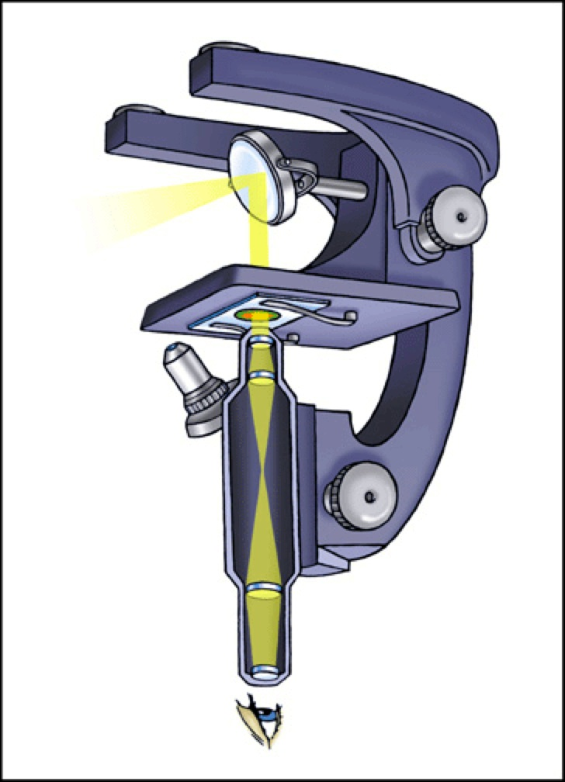
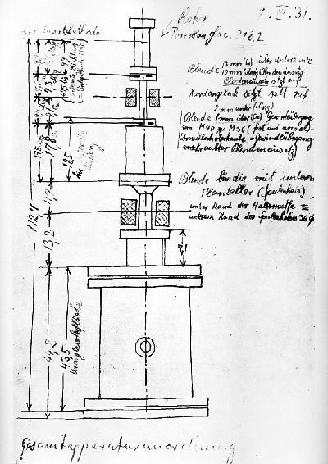
Principle
condenser lens
objective lens
projector lens

Slide 5
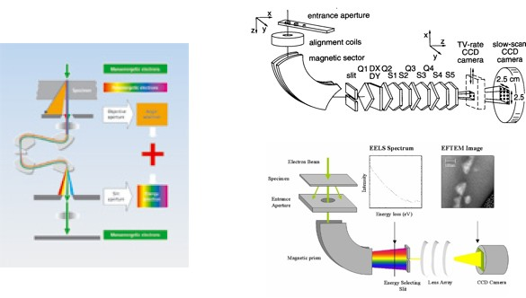
Sorting Electron by Energy

Slide 6
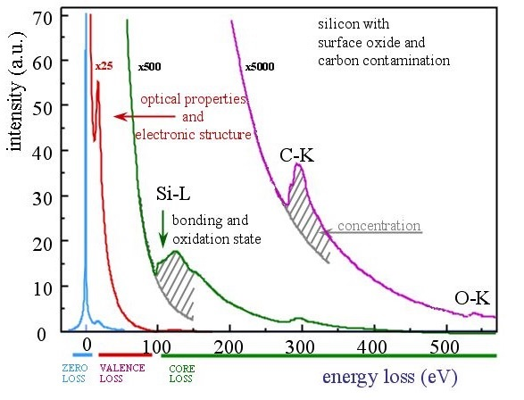
Electron Energy-Loss Spectroscopy

Slide 7
Why do microscopy with electrons
Small Wavelength
You cannot resolve anything much smaller than your wavelength
Lenses
The reason one does not have X-ray and neutron microscopes is that there is no lens for those particles
Atomic scale resolution is possible with electron and ion microscopy

Slide 8
Understanding Size
How small is small ?

Slide 9

Understanding Size
1 m
Source: CERN

Slide 10

Understanding Size
10 cm
Source: CERN

Slide 11
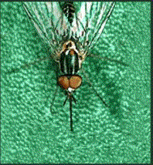
Understanding Size
1 cm
Source: CERN

Slide 12
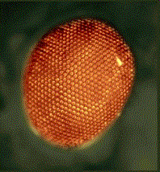
Understanding Size
100 μm
Source: CERN

Slide 13
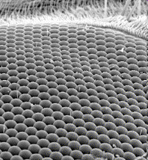
Understanding Size
10 μm
Source: CERN

Slide 14
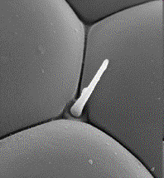
Understanding Size
1 μm
Source: CERN

Slide 15
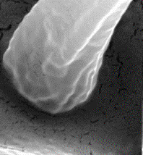
Understanding Size
100 nm
Source: CERN

Slide 16
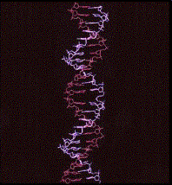
Understanding Size
10 nm
Source: CERN

Slide 17
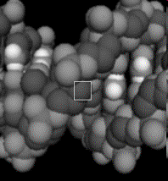
Understanding Size
1 nm
Source: CERN

Slide 18
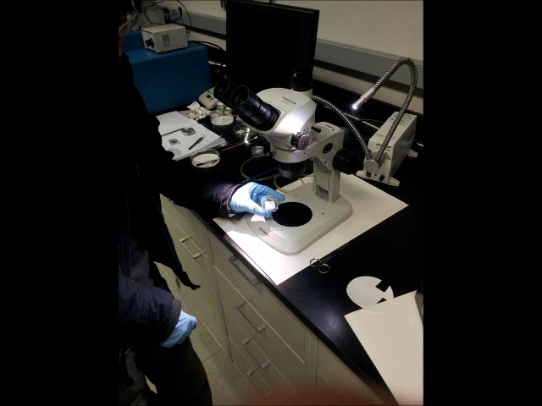
Macro to Nano

Slide 19
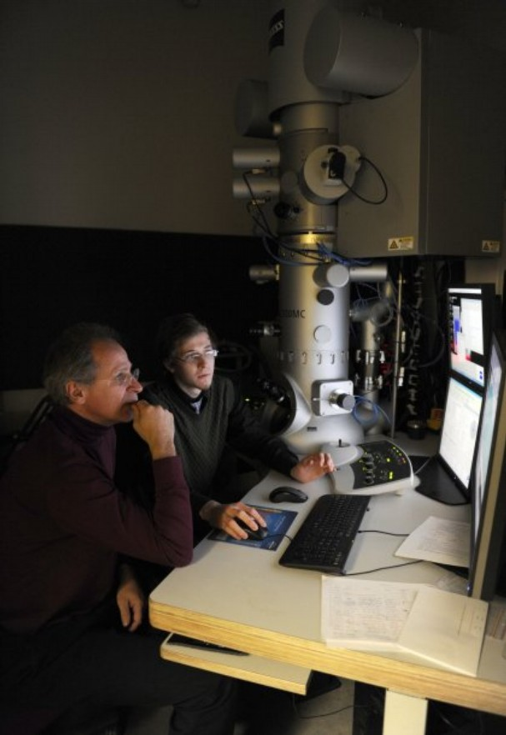
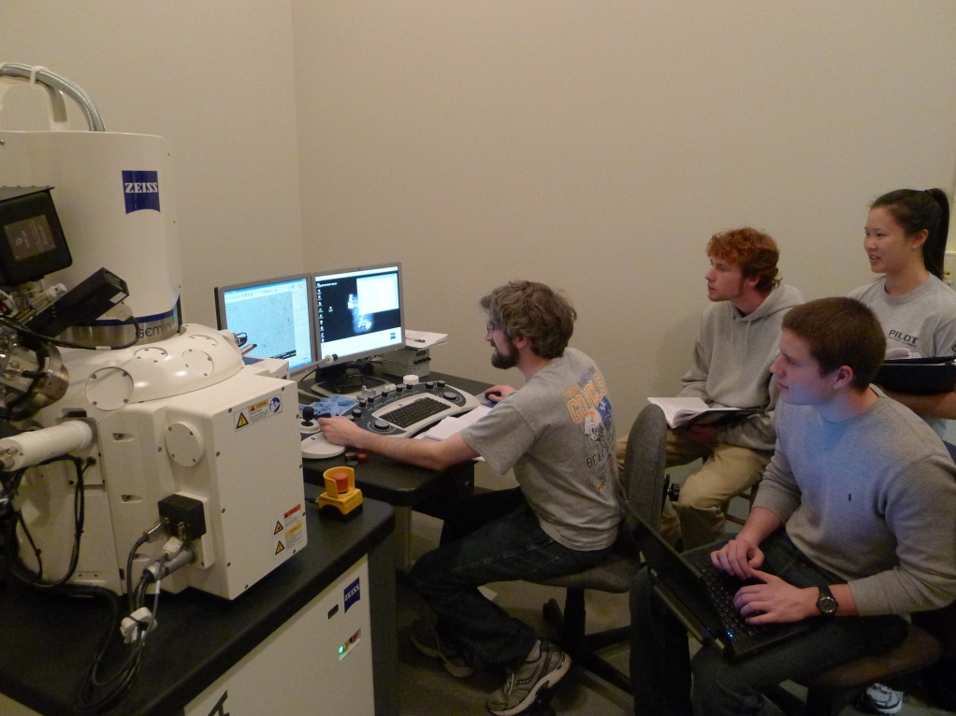

Education
State of the art electron microscopes available to graduate student research and undergraduate classes
Almost all possible methods of electron microscopy can be taught and utilized on these devices
Training
so the more specialized instruments at ORNL can be used effectively

Slide 20
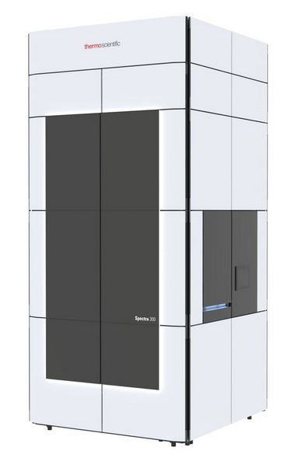
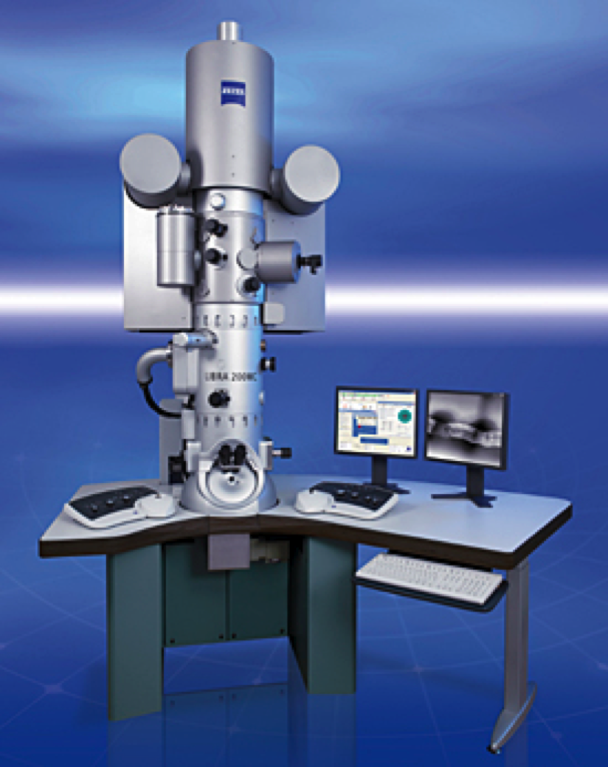
Transmission Electron Microscope
Complimentary capabilities to ORNL
monochromator and cryogenic tomography
Biological and polymer materials a strong research focus at UT
Hybrid materials
characterization of combination's of soft and solid materials is ideally suited for this instruments

Slide 21
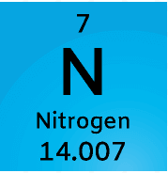
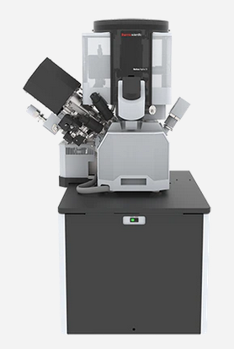
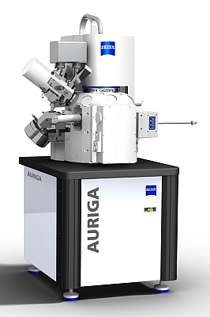
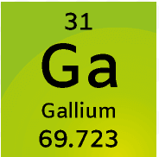
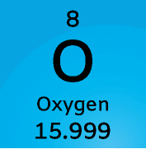
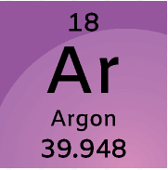
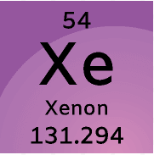

Focused Ion Beam
Nano-machining
Electron microscope sample preparation
Electrical and mechanical testing
Hydra

Slide 22
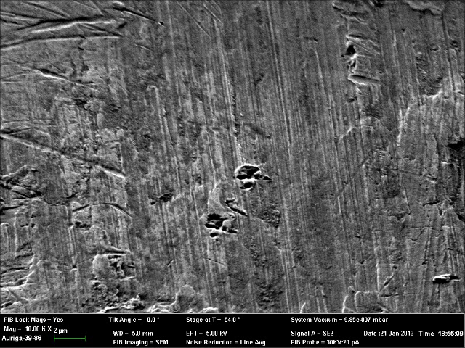

Slide 23
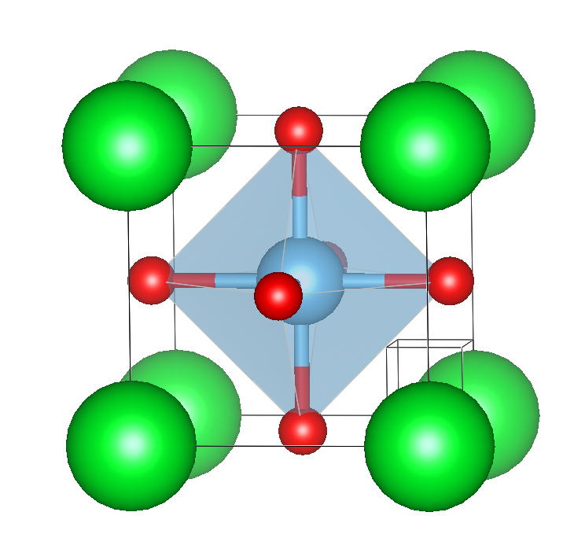
Unit Cell: The smallest unit of a crystal

Slide 24
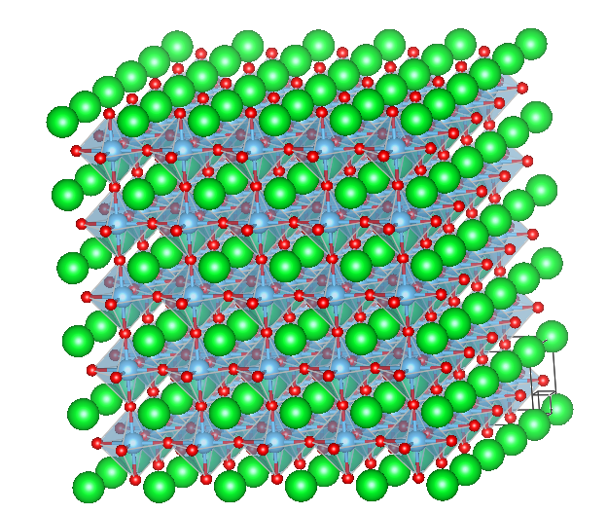
Seeing atoms
No

Slide 25
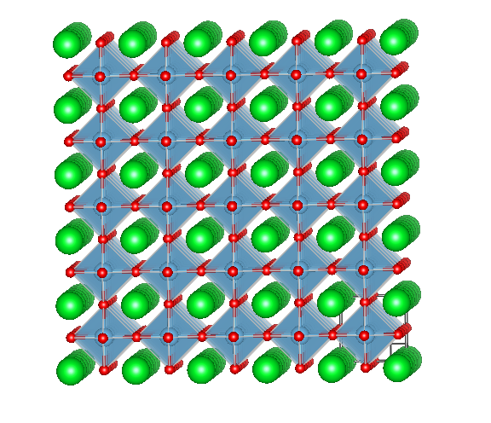
Seeing atoms
No,
just atomic columns

Slide 26
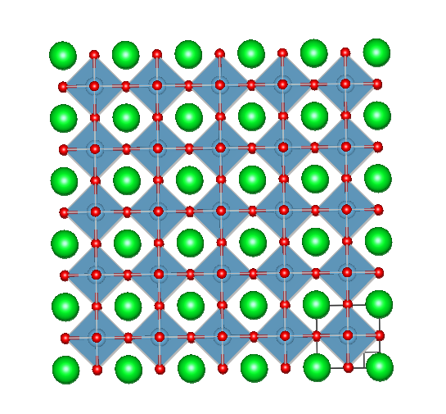
Seeing atoms
No,
just atomic columns
viewed
edge
on

Slide 27
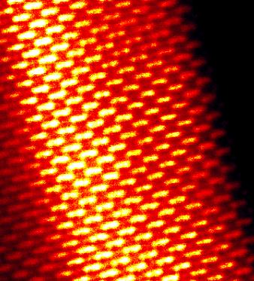

Slide 28
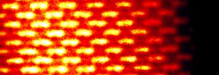
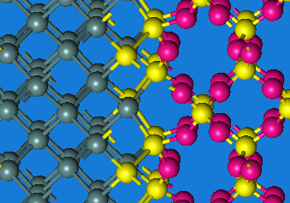
Ge/SiO₂ Interface
Ge
SiO₂
One layer with significant Ge reduction as transition layer.
Just one layer of Si²⁺ before stochiometric SiO₂.
This is consistent with atomically abrupt interface.
10
5
0
0
1
2
3
nm

Slide 29
Single Silicon atoms on graphene

Slide 30
Single Layer - Boron Nitride
N_{B}
N_{B}
1 nm
1 nm

Slide 31
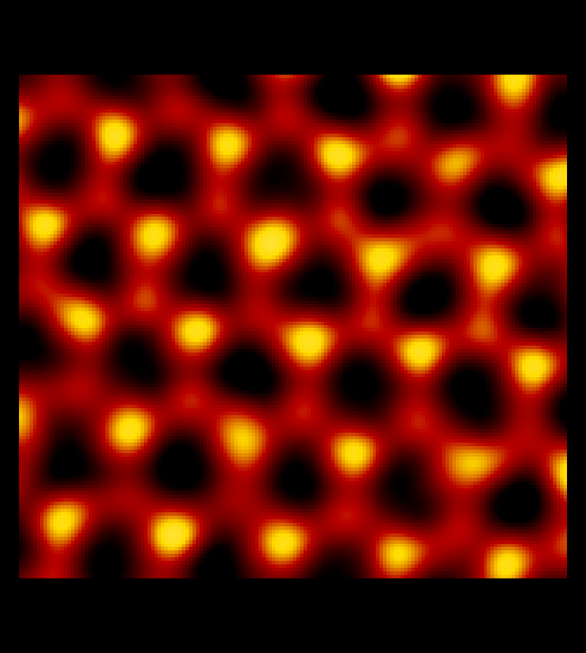
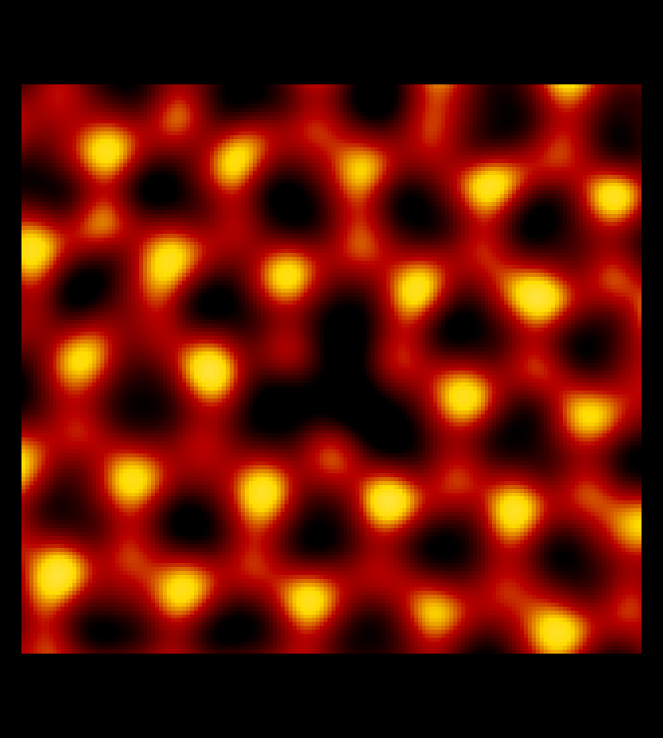
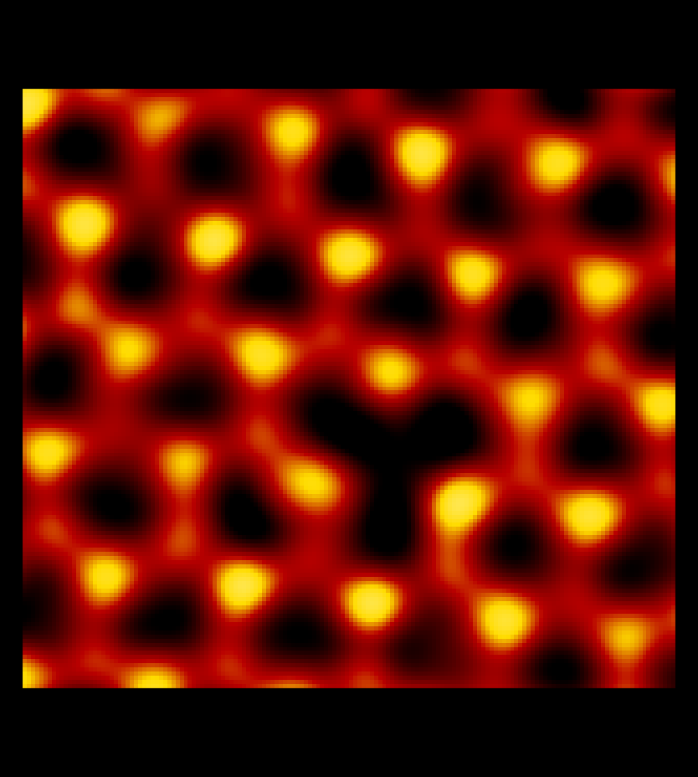
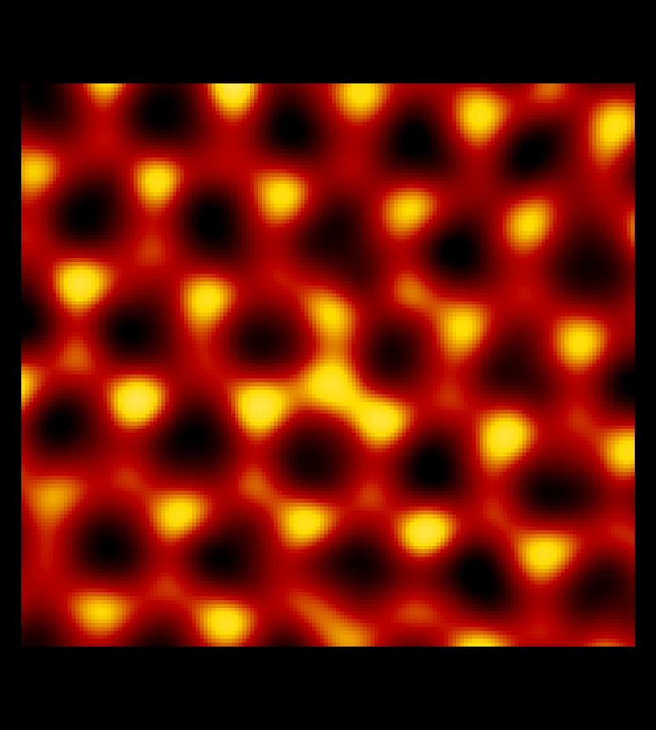
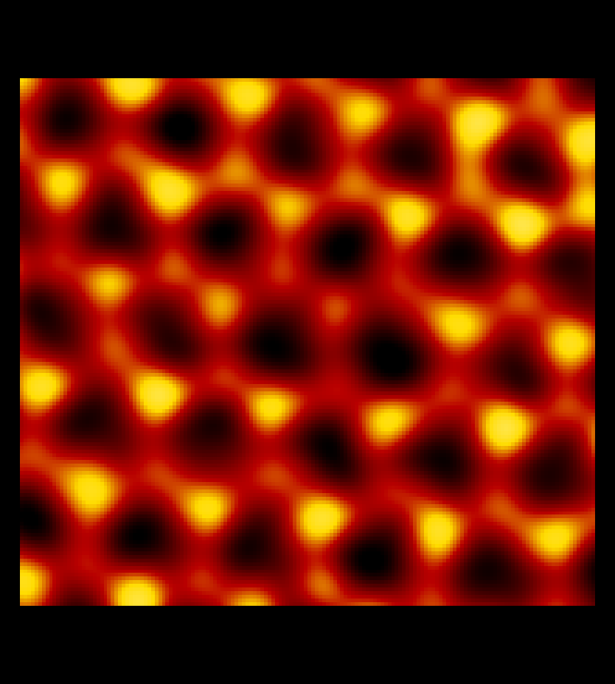
Counting Point Defects in CVD-Grown BN
Perfect Atom Sites | N Vacancies | B Vacancies | N Antisites | B Antisites
303,874 | 68 | 276 | 228 | 53
0.5 nm

Slide 32
Summary
Many Instruments
Many Techniques
Many Possibilities
Use the cool TEMs in your neighborhood.
It is fun !

